Slide 1
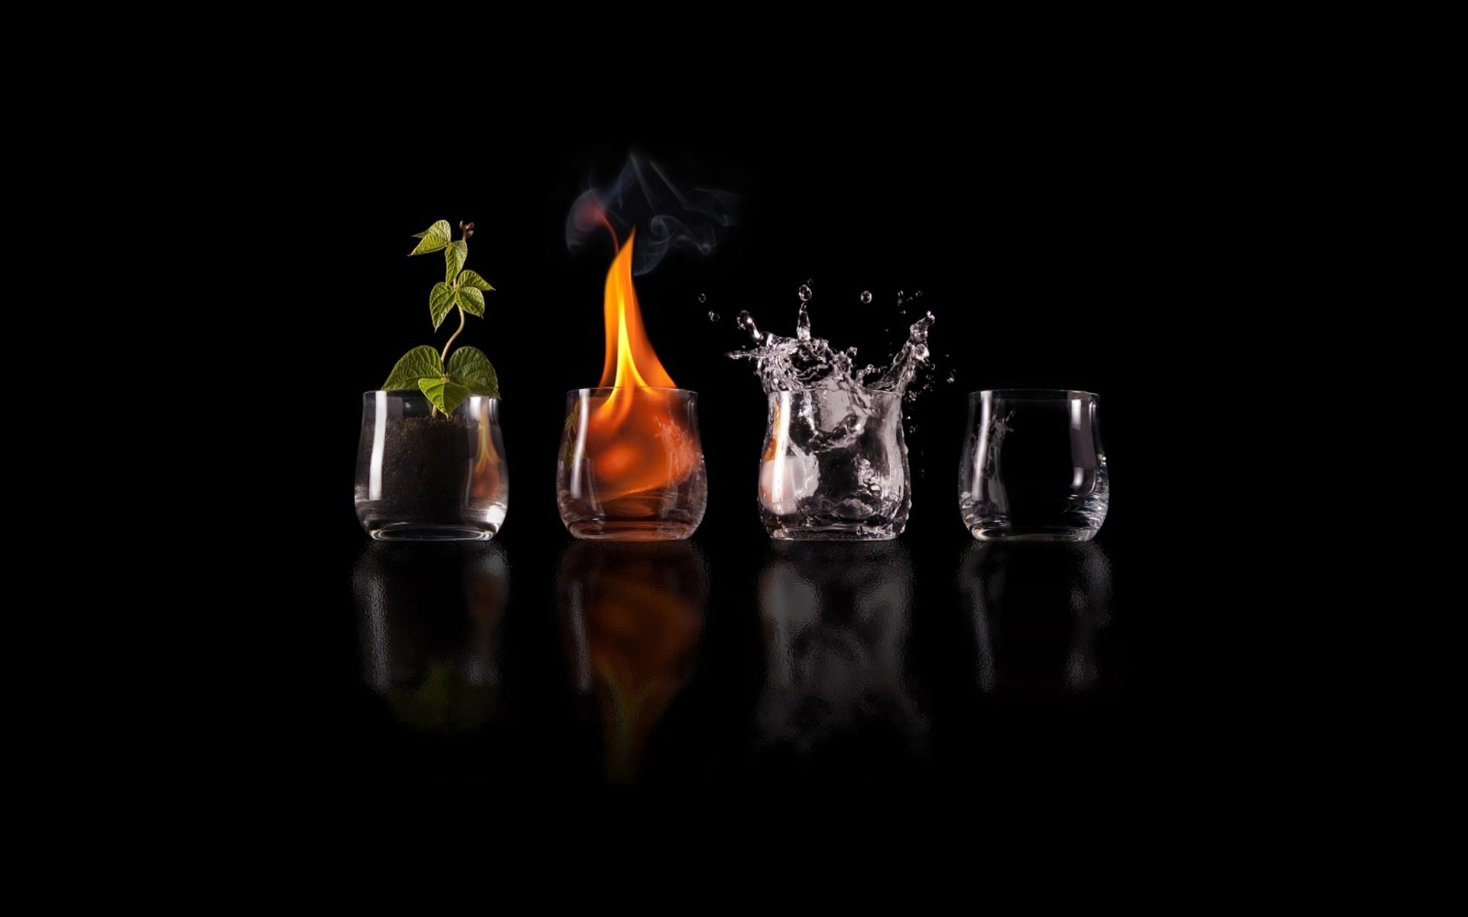
THERMODYNAMICS Dr Sanal kumar
Lekshmy

Slide 2
CONCEPT OF ENERGY
Energy is the capacity to do work
Exists in two forms: POTENTIAL and KINETIC
Potential- stored in bodies or in chemicals
Kinetic- energy of action used during the performance of work
Potential energy can be chemical/ electric/ atomic
Kinetic energy may be thermal or mechanical
In biological systems, energy is available in the form of chemical energy

Slide 3
Living things utilize chemical energy through high energy phosphate compounds. Eg. ATP, which on hydrolysis yield ADP and 8500 cal. of free energy
The universality of ATP and ADP suggests these compounds appeared early in the biotic environment
Three transfer points of biological energy
photophosphorylation
ATP in carbohydrate/ protein/ fat
light
1
2
Oxidation
Biosynthesis
Active transport
3
ATP

Slide 4
FREE ENERGY CONCEPTS
Free energy of a system is the part of its total potential energy which is available for useful work
Eg. 1. When water flows downhill, the free energy is used to generate electricity
2. When coiled spring unwinds, its free energy an be used to turn hands of a clock
In thermodynamics, those reactions proceedings with a loss of free energy are said to be exergonic reactions
The reverse of these reactions need an input of free energy.
Eg. Water must be pumped uphills
Clock must be wound

Slide 5
Such reactions are endergonic reactions
At equilibrium, according to law of mass action, the product of the concentration of products formed divided by the product of the concentration of reactants is a constant called equilibrium constant
A + B C + D
[C] [D]
[A] [B]
K =

Slide 6
The relationship between equilibrium constant and free energy is:
ΔG⁰ = -RT log K
Where,
ΔG⁰ = free energy change
R = Universal gas constant (1.99cal/mule/degree)
T = absolute temperature
When K=1, log K = log 1= 0 ( 0 X RT= 0); ΔG = 0 i.e., no change in free energy
If product concentration is great; K > 1, the reaction is exergonic
If K < 1, the reaction will not proceed without supply of free energy

Slide 7
Systems and surroundings
Universe has TWO parts
SYSTEM
SURROUNDINGS
SYSTEM:
- may be the part of the universe selected for the purpose of theoretical investigations
SURROUNDINGS :
– all other matter interact with the system

Slide 8
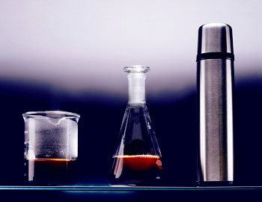
TYPES OF SYSTEMS
System: 3 types – 1. OPEN 2. CLOSED 3. ISOLATED
Open system- can exchange both mass and energy with surroundings
Eg. Biological systems
Closed system- exchange of energy & not matter with the surroundings
Eg. Fluorescent lamp
Isolated system – no mass and energy exchange
Eg. Thermoflask

Slide 9
Internal energy (E) & Internal energy change (ΔE)
The energy associated with a substance depends on its nature and composition called internal energy (E)
Internal energy change is change in internal energy during a chemical reaction
ΔE = Σ E products – Σ E reactants

Slide 10
High energy compounds
If 5- 7 Kcal/mole free energy liberated on hydrolysis – high energy compounds
If lower than 5 K cal/ mole free energy liberated on hydrolysis, such compounds are energy poor
ATP
ADP + 8500 cal/mole
Glucose 6 phosphate
3300 cal/mole

Slide 11
High energy phosphate bonds are unhydride linkages between two molecules of phosphoric acid or between a molecule of phosphoric acid and a carboxylic acid
These bonds are highly unstable and yield high amount of energy on hydrolysis
Unhydride linkage- reaction in which a molecule of water is eliminated
OH
OH
OH
OH
OH
OH
OH
OH
Between phosphoric acid

Slide 12
OH
OH
OH
OH
Between Phosphoric acid and Carboxylic acid
Low energy compounds have ester linkage between phosphoric acid and the alcoholic group of a sugar and are resistant to hydrolysis and yield small amount of energy
OH
OH
OH
OH

Slide 13
There are three types of energy rich compounds
Primary phosphorelating agents – ATP, GTP, UTP
Transient intermediates- act as intermediates in phosphorelating reactions Eg. Acetyl CoA, Phospho enol pyruvate, Glyceral phosphate
Energy reservoirs- compounds from primary phosphorelating agents can be made on emergency
Eg. Guanidine phosphate in animals
Inorganic polyphosphate in plants

Slide 14
LAWS OF THERMODYNAMICS
1st law:- Energy can neither be created nor destroyed, but can be changed from one form to another form
ENTHALPY: It is the sum of the internal energy and the pressure volume energy of the system
H = E + PV
HESS’s LAW: The enthalpy change of a chemical reaction is the same whether the process is carried out in one step or more steps
C + O → CO₂
C + O → CO + O → CO₂
Enthalpy change same

Slide 15
2nd law:- It is impossible to convert heat into work without compensation i.e., without making a change
Energy flows hotter→ colder molecules spread i.e., goes from order to disorder
This degree of order or disorder of a molecule in a system is entropy
Solids – lowest degree of entropy
Gases – highest degree of entropy
Liquids – intermediate degree of entropy

Slide 16
3rd law:- The entropy is the measure of disorder of any system. The disorder increases with increase of temperature and decrease with decrease of temperature. At absolute zero, entropy is zero

Slide 17
Life as an autocatalytic system
CATABOLISM
Cellular metabolism
ANABOLISM
Aging ANABOLISM < CATABOLISM
Catalytic activity of enzymes and nature of enzymes
In living system, there is low energy of activation of a chemical reaction in the cell due to the presence of enzymes

Slide 18
So living system need not go in search of external catalyst to start a chemical reaction
Metabolic pathways are going on well with less expenditure of energy

Slide 19
THANK YOU

